Slide 1
Nice Ride Minnesota 2017
DSB3
Done: WADEEA

Slide 2
Introduction:
This project will analyze trip, station, and weather data to identify the periods and stations with the highest demand, compare demand with station capacity, and examine how weather affects bike usage

Slide 3
Problem Statement:
In 2017, Nice Ride Minnesota recorded 460,718 bike trips across 202 stations. Bike usage varied across different times, stations, user types, trip durations, and weather conditions. Understanding these patterns can help identify periods of high demand, differences in user behavior.

Slide 4
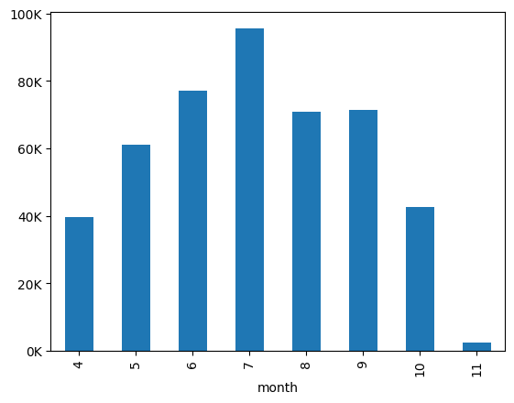
1a-How does bike demand change by month ?
Bike demand increased from April to July and then started to decrease. July had the highest number of trips.This could be because people prefer cycling during the warm summer months

Slide 5
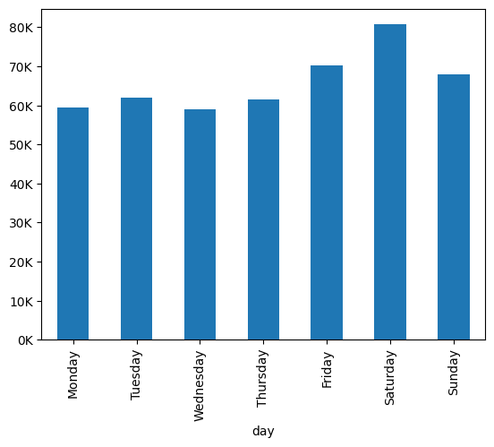
1B-How does bike demand change by day ?
Saturday had the highest bike demand, while weekday demand was lower. This could be because people have more free time on weekends to ride bikes.

Slide 6
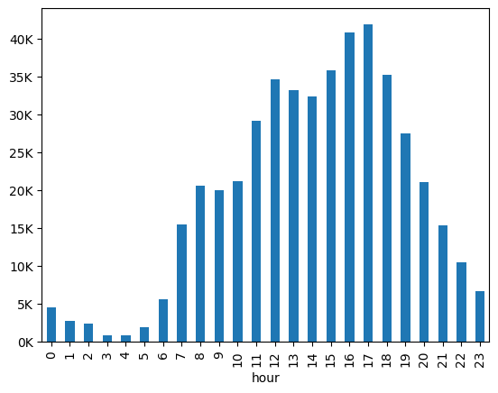
1C-How does bike demand change by hour?
Bike demand increased throughout the day and reached its highest level at 5 PM. After that, demand started to decrease during the evening hours.

Slide 7
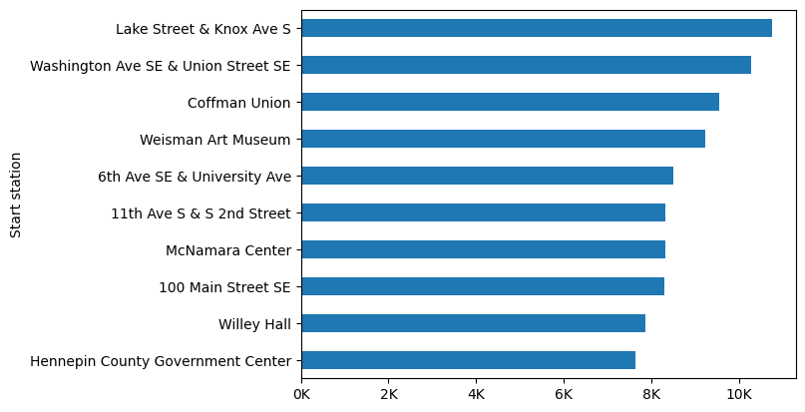
2A-Which stations have the highest bike demand?
Lake Street & Knox Ave S recorded the highest demand due to its location near popular destinations and high-traffic areas.

Slide 8
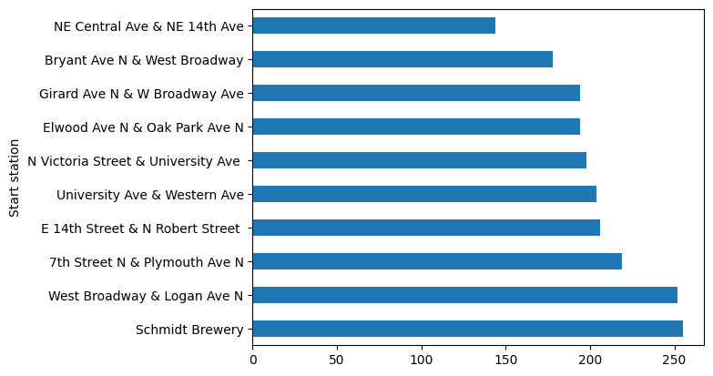
2B-Which stations have the lowest bike demand?
NE Central Ave & NE 14th Ave had the lowest bike demand because it is located in a less active area with fewer riders and destinations compared to other stations.

Slide 9
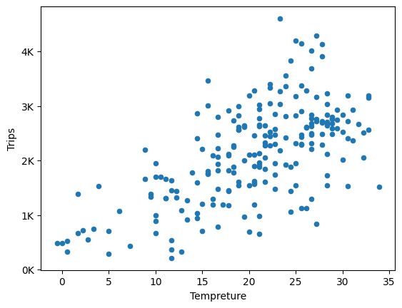
3-How does weather affect daily bike demand?
Bike demand increased as temperature increases. Warmer weather encouraged more people to use bikes, resulting in a higher number of trips.

Slide 10
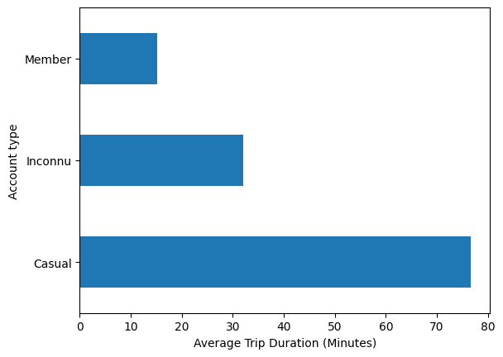
4- Do members and casual users use bikes differently?
Casual users spend more time on their trips, showing that they mainly ride for leisure.
Members have shorter trips, which suggests regular daily use.

Slide 11
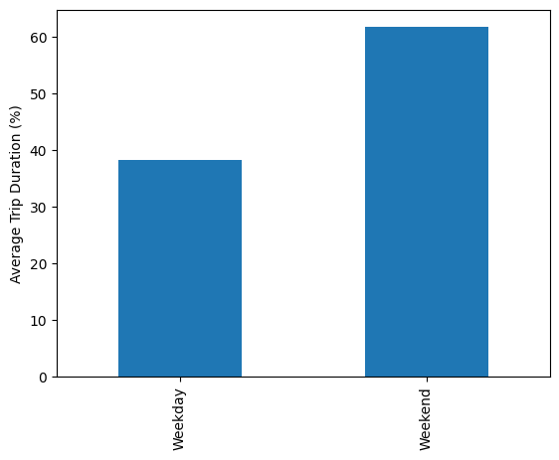
5- Are bike trips longer on weekends or weekdays?
Weekend trips had a higher average duration than weekday trips. This shows that riders spent more time cycling on weekends.

Slide 12
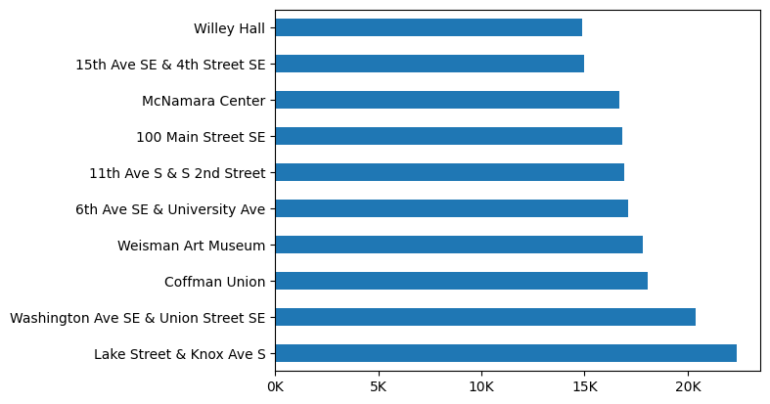
6- Which stations are most commonly used as both start and end stations?
Understanding station demand helps improve bike availability and ensures that bikes are placed where riders need them most.

Slide 13
Conclusion :
Bike demand showed clear variations across different times and stations, highlighting specific periods and locations with higher levels of activity.
Weather conditions also influenced daily bike usage, suggesting that external factors can affect overall demand throughout the year.

Slide 14
recommendation :
Increase bike availability at high-demand stations
Add more bikes during peak hours.
Consider weather when planning bike availability

Slide 15
Next Step:
Further analysis could explore user types, trip duration, and station usage to identify different usage patterns.
These insights could support better bike availability and more efficient station planning.

